Slide 1
K- NEAREST NEIGHBOUR (KNN)

Slide 2
KNN algorithm
K-Nearest Neighbour is one of the simplest ML algorithms based on Supervised learning
technique.
K-NN algorithm assumes the similarity between the
New case/data and available cases.
It is a simple easy to implement, lazy learning,
Supervised ML algorithm that can be used to solve both classification and regression problems using
Feature similarity.

Slide 3
Lazy Algorithm as KNN doesn’t have a training step.
All data points will be used only at the time of prediction . with no training Step, prediction step is costly .

Slide 4
K in K nearest neighbors
K is a number used to identify sillier neighbors for the new data
Point.
Referring to our example of friend circle in our new neighborhood . We select 3 neighbors that we want to be very close friends based on common thinking or hobbies. In this case K is 3.
KNN takes K nearest neighbors to decide where the new data point with belong to. This decision is based on feature similarity.
K is a parameter that refers to the number of nearest neighbours to include in the majority if the voting process .

Slide 5
Steps in KNN
Step 1: Choose a value for K. K should an odd number.
Step 2: Finding the distance of the new point to each of the training data.
Step 3: Find the K nearest neighbours to the new data point .
Step 4: For classification , count the number of data points in each category among the K neighbours . New data point will
belong to class that has the most neighbours.
For Regression value for the new data point will be the average
of the K neighbours.

Slide 6
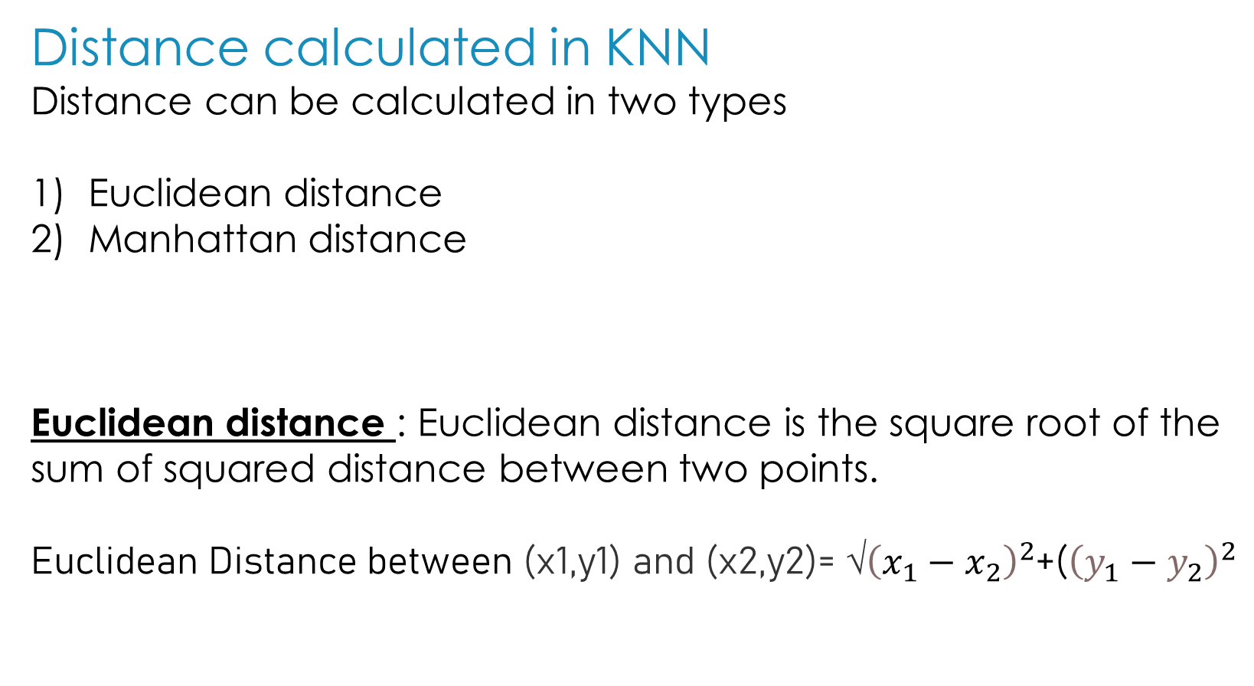
Distance calculated in KNN
Distance can be calculated in two types
Euclidean distance
Manhattan distance
Euclidean distance : Euclidean distance is the square root of the sum of squared distance between two points.
Euclidean Distance between (x1,y1) and (x2,y2)= √${\left(x_{1}−x_{2}\right)}^{2}$+(${\left(y_{1}−y_{2}\right)}^{2}$

Slide 7
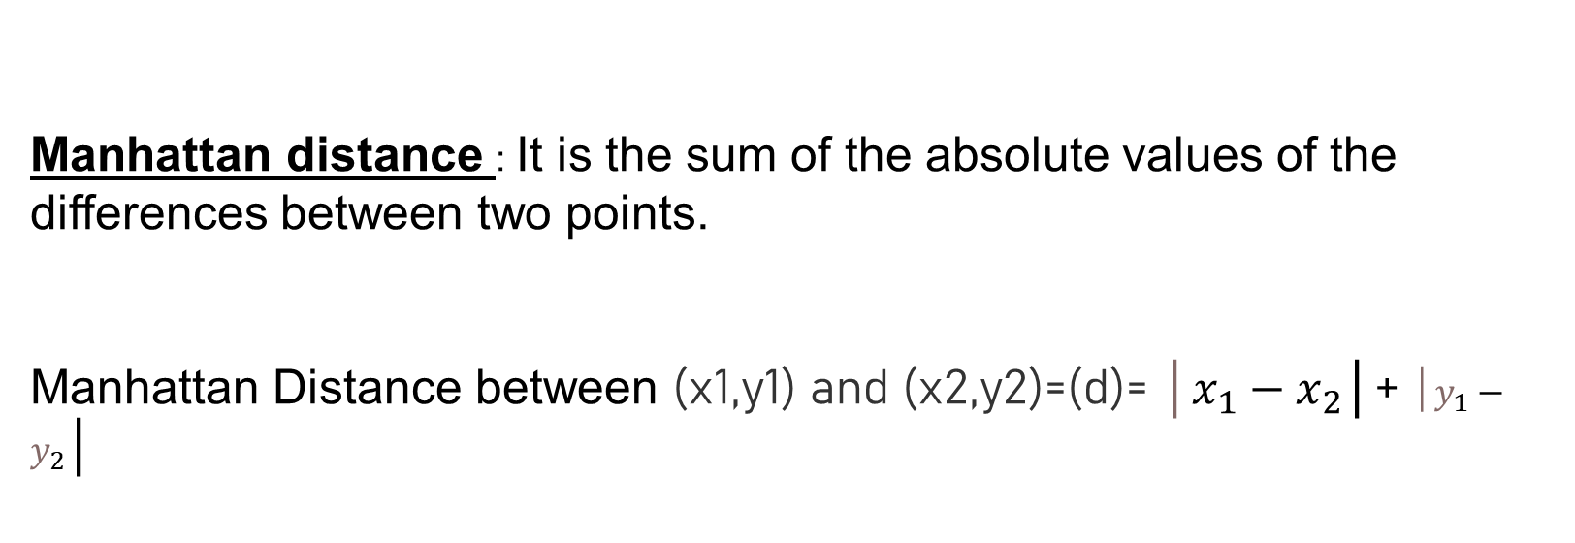
Manhattan distance : It is the sum of the absolute values of the differences between two points.
Manhattan Distance between (x1,y1) and (x2,y2)=(d)= │$x_{1}−x_{2}$│+ $│y_{1}−y_{2}$│

